Slide 1
NLP – spaCy library
- Varnika Milind Mulay

Slide 2
Contents
1. Introduction to NLP and spaCy
2. spaCy features
3. spaCy Pipeline
4. Applications of spaCy

Slide 3
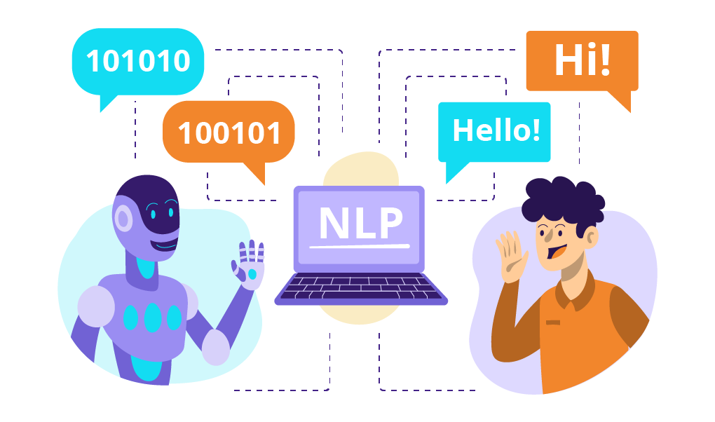
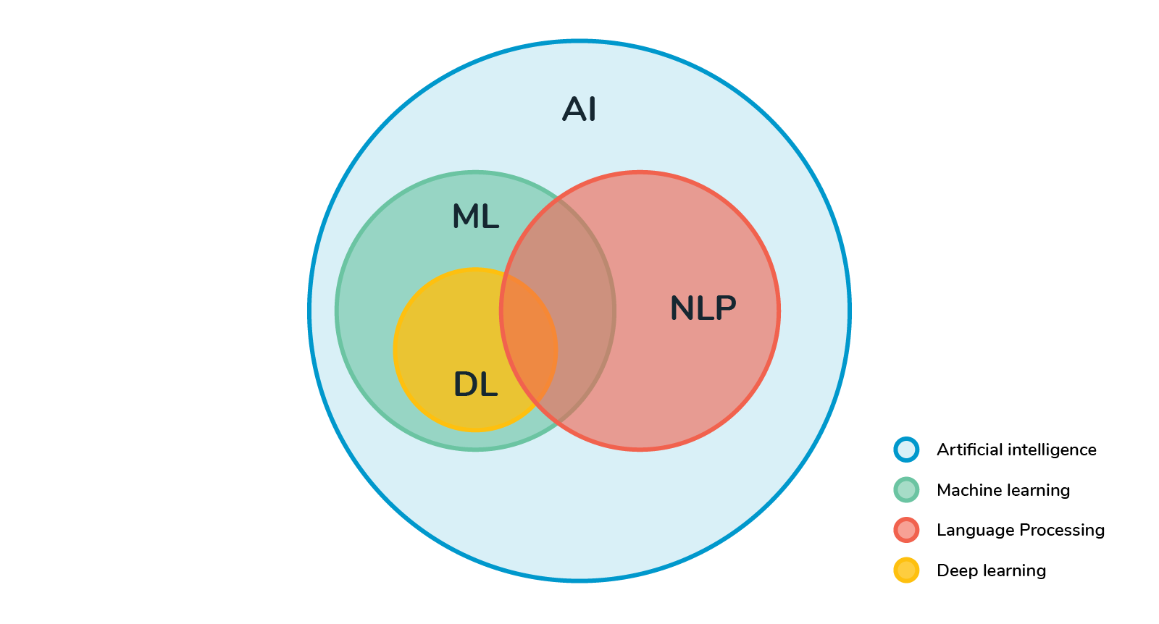
Introduction to NLP
Stands for Natural Language Processing
Subfield of artificial intelligence (AI) focused on the interaction between computers and humans through natural language.
Enable computers to understand, interpret, and generate human language in a meaningful and useful way.
https://www.sentisum.com/library/nlp-and-text-mining
https://revolveai.com/natural-language-processing-techniques/

Slide 4
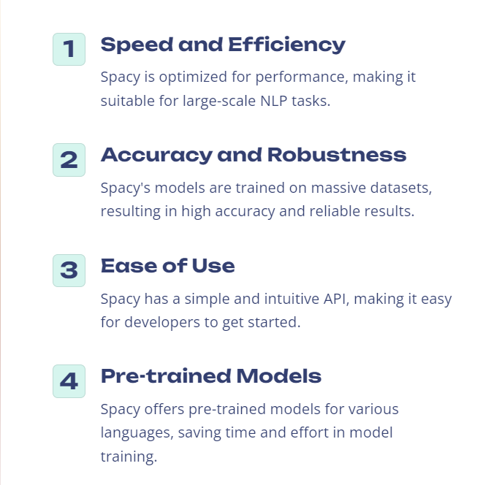
Introduction to spaCy
spaCy is a free, open-source library for advanced Natural Language Processing (NLP) in Python written in Cython.
Designed to make it easy to build systems for information extraction or general-purpose natural language processing.
Designed for production use, with a focus on speed, accuracy, and ease of use.
Offers a variety of features and tools that enable developers to build NLP applications for a wide range of tasks.

Slide 5
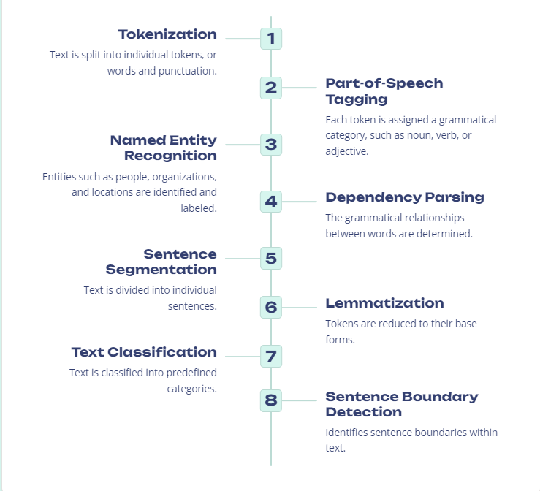
Features of spaCy

Slide 6
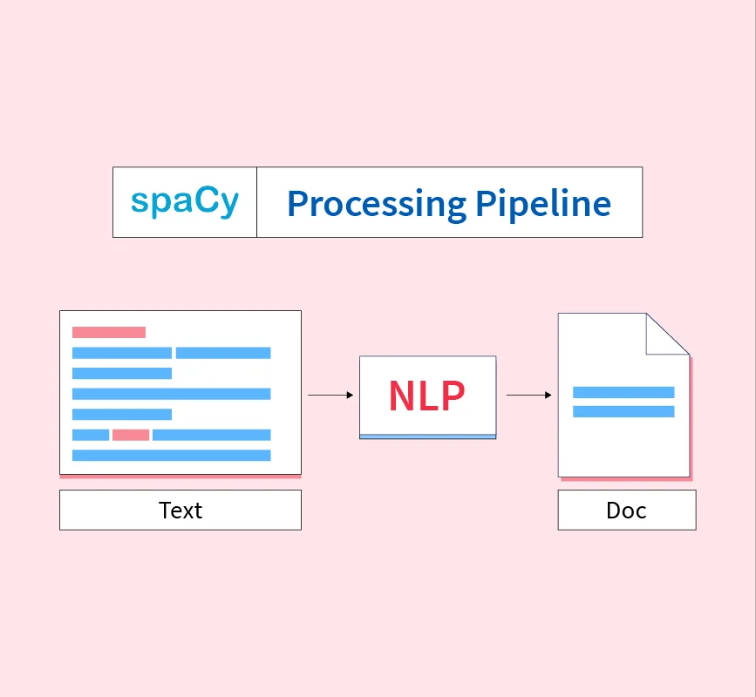
spaCy Pipeline
The processing of our text (which is termed as Doc in the spaCy library) is done in various incremental stages. These incremental stages are known as the processing pipeline spaCy.
the spaCy pipeline uses the stages to convert the user input text into a machine-understandable Doc object.
https://www.scaler.com/topics/nlp/processing-pipeline-spacy/

Slide 7
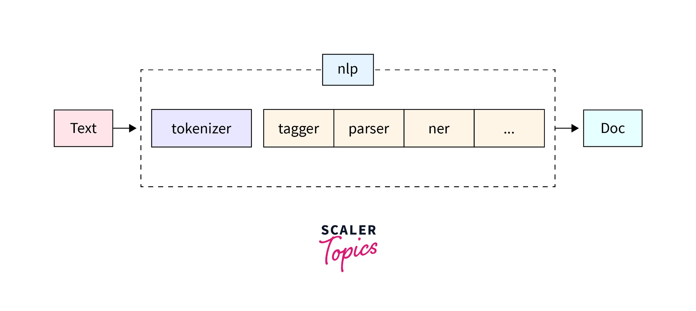
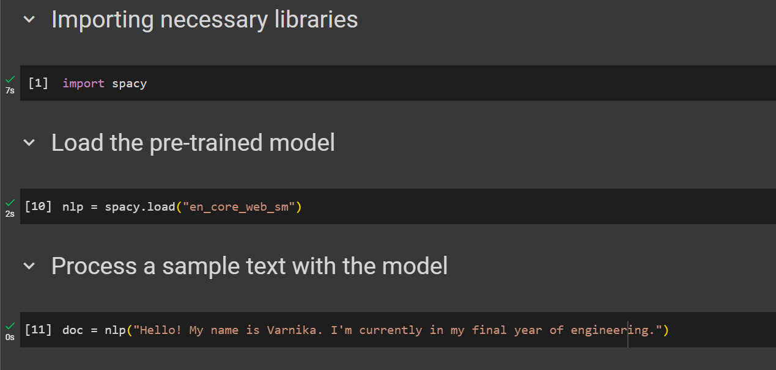
Elements of the spaCy pipeline
https://www.scaler.com/topics/nlp/processing-pipeline-spacy/
Text: This is the raw input text that you want to process.
Nlp: The nlp object is an instance of a spaCy language model. It orchestrates the entire pipeline, managing the sequence of processing steps.

Slide 8
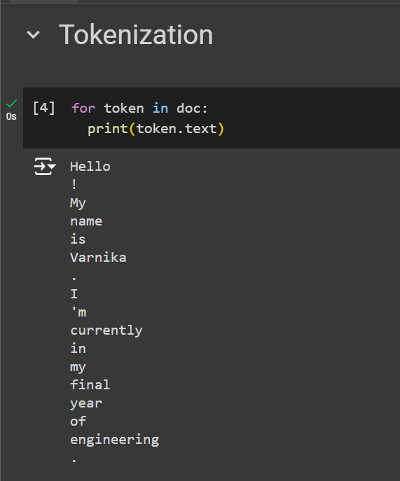
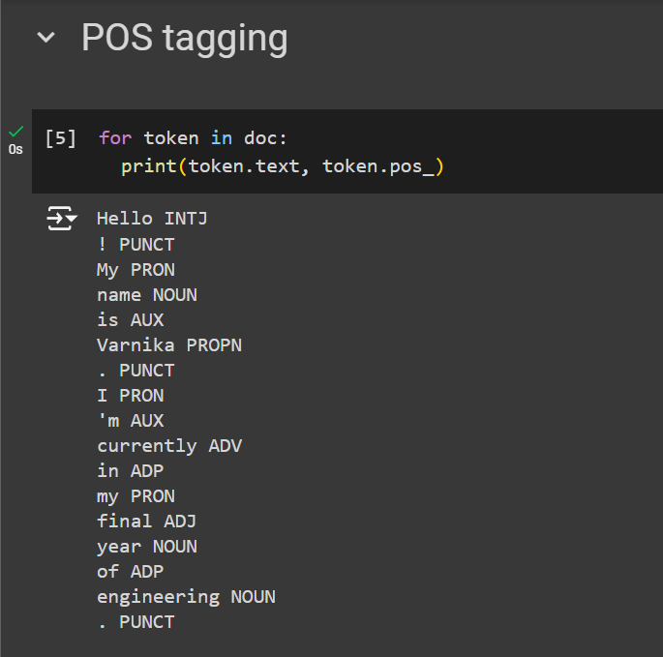
Tokenizer: The tokenizer is the first component in the pipeline. It splits the raw text into individual tokens (words, punctuation marks, etc.).
Tagger: The tagger assigns part-of-speech (POS) tags to each token, indicating its grammatical role (e.g., noun, verb, adjective).

Slide 9
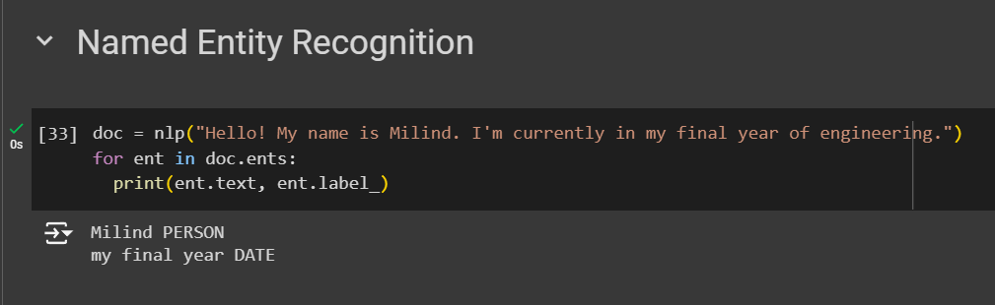
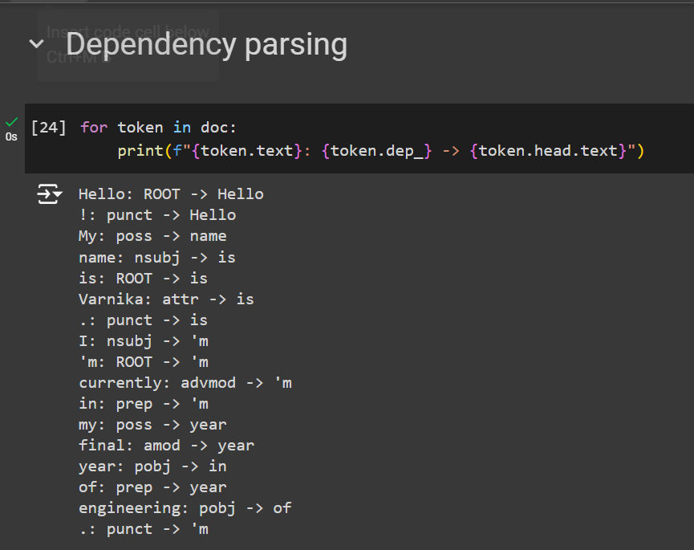
Parser: The parser analyzes the syntactic structure of the sentence, establishing dependencies between tokens (e.g., subject, object, modifiers).
NER (Named Entity Recognition): The NER component identifies named entities in the text, such as names of people, organizations, locations, dates, and monetary amounts.
Doc: The output of the pipeline is a Doc object, which contains the processed text and annotations. This object provides access to the tokens, POS tags, dependencies, named entities, and other information.

Slide 10
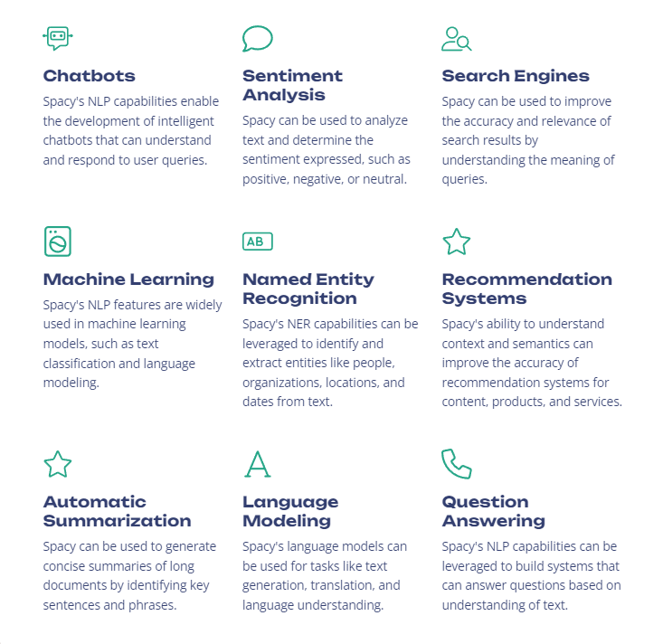
Applications of spaCy

Slide 11
Thank You!

